Slide 1
UNIVERSITY INSTITUTE OF COMPUTING
Bachelors of Computer Applications
ANIMALIA
(A Platform for Animal Rescue, Volunteering, and Donations)
Student Name : VAGESH, ROBIN, SAKSHI
UID : 22BCA10945 , 22BCA10966, 22BCA10956
Section/Group : 22BCA 9(A)
Supervisor Name: SUMEET PRASHAR
Designation: Assistant Professor
DISCOVER . LEARN . EMPOWER

Slide 2
INTRODUCTION
Animalia is a platform where you can adopt, donate, and rescue animals.
It acts as a medium between rescuers and donors, streamlining support for animals in distress.
Designed to bridge the gap between the public, volunteers, rescue teams, and shelters.
Enables real-time reporting of emergencies, ensuring swift action and medical care for animals.
Offers a centralized dashboard for managing rescue cases, adoptions, donations, and volunteer activities.
Promotes a community-driven approach, engaging youth and animal lovers in awareness and welfare efforts.
Aims to create a tech-powered support system for animal care using location services, image recognition, and AI tools.

Slide 3
Technology Used
HTML5 – Used to define the structure of web pages. It provides the semantic layout of content including headings, forms, buttons, and multimedia elements.
CSS3 – Responsible for styling and presentation. It handles layout, color schemes, typography, animations, and responsive design to ensure a visually appealing and user-friendly interface.
JavaScript – Adds interactivity and dynamic behavior to the platform. It manages form validation, DOM manipulation, event handling, and asynchronous data fetching using APIs.
Node.js with Express.js – Manages backend operations and server-side logic. Node.js handles scalable, non-blocking operations, while Express.js simplifies routing and API creation.
MongoDB – A NoSQL document-based database used to store and retrieve data such as volunteer data, adoption data, and contact information in a flexible and scalable way.

Slide 4
Existing Gaps & Project Features
Gaps in current systems:
No centralized system for animal rescue and donations.
Poor adoption tracking and transparency.
Lack of local volunteer-rescuer coordination tools.
Animalia’s Features:
Real-time reporting of rescue cases with image uploads and location tracking.
Verified volunteer and rescue profiles for task assignment and tracking.
Centralized adoption portal with browsing, filtering, and application system.
Secure donation system with transparent fund tracking.
Post-adoption support and follow-ups to ensure animal welfare.

Slide 5
Objectives
Build a user-friendly web application for animal rescue and adoption.
Facilitate quick rescue reporting and volunteer dispatch using geolocation.
Promote responsible pet adoption and reduce street animal population.
Enable youth participation through volunteering and awareness programs.
Foster transparent fundraising to support medical treatments and shelter needs.
Integrate location services to enhance rescue workflows.

Slide 6
Scope/Relevance
Relevant for animal shelters, NGOs, donors, and volunteers.
Scalable to rural and urban areas with a web + mobile compatible interface.
Can be integrated with municipal animal rescue units and emergency services.
Serves as an educational tool for schools, colleges, and social groups to spread awareness.
Promotes digital compassion and social accountability among youth.

Slide 7
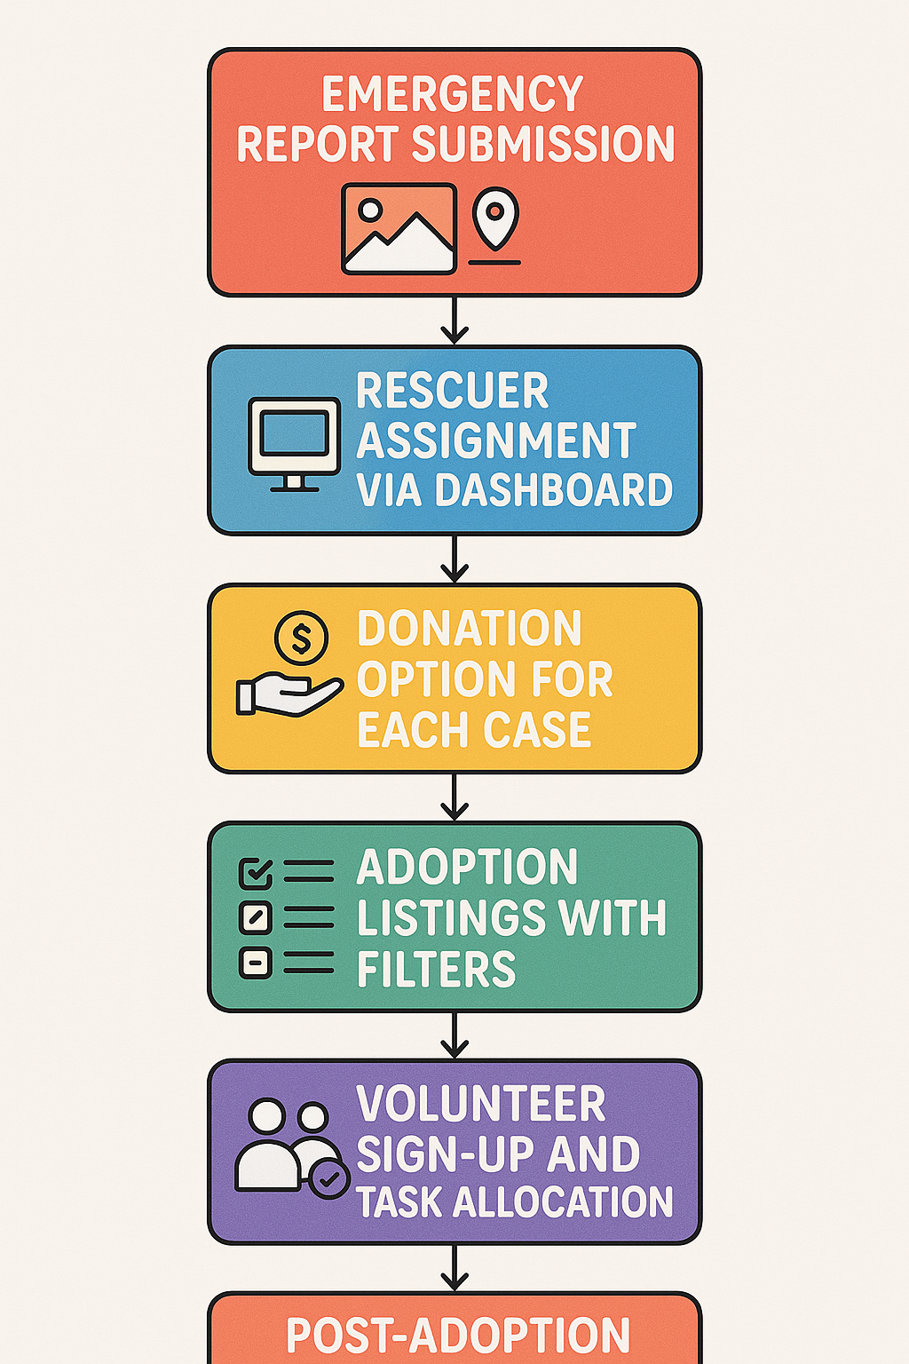
Flow Diagram

Slide 8
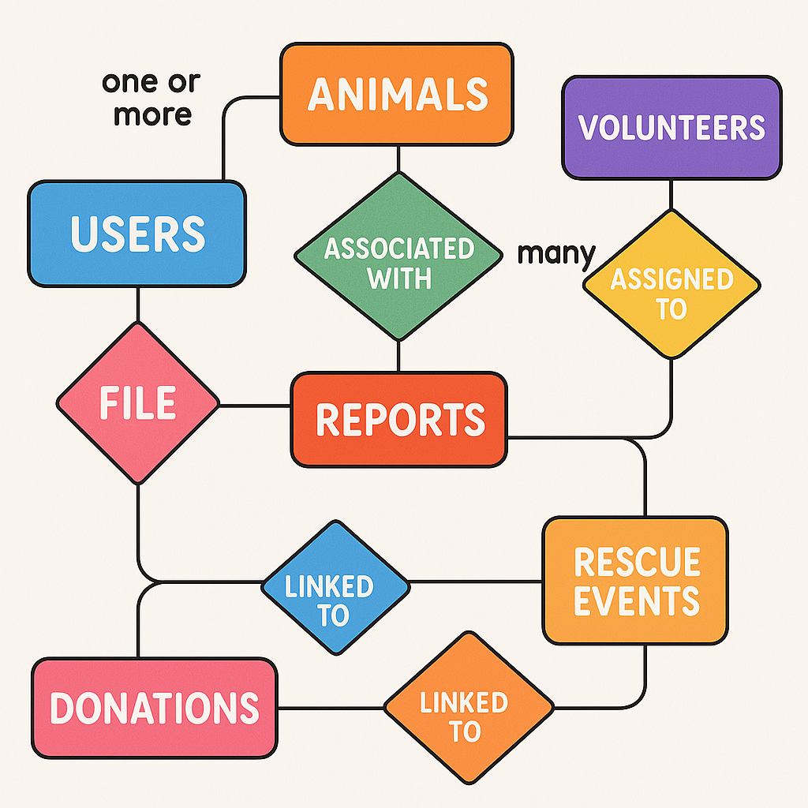
ER Diagram

Slide 9
Test Cases
Rescue report with and without image/location.
Volunteer assignment – valid vs invalid user role.
Donation – simulate payment gateway mock testing.
Adoption process – ensure application form validation and record creation.
Responsiveness across desktop and mobile views.
Database test cases (e.g., data retrieval, data integrity).

Slide 10
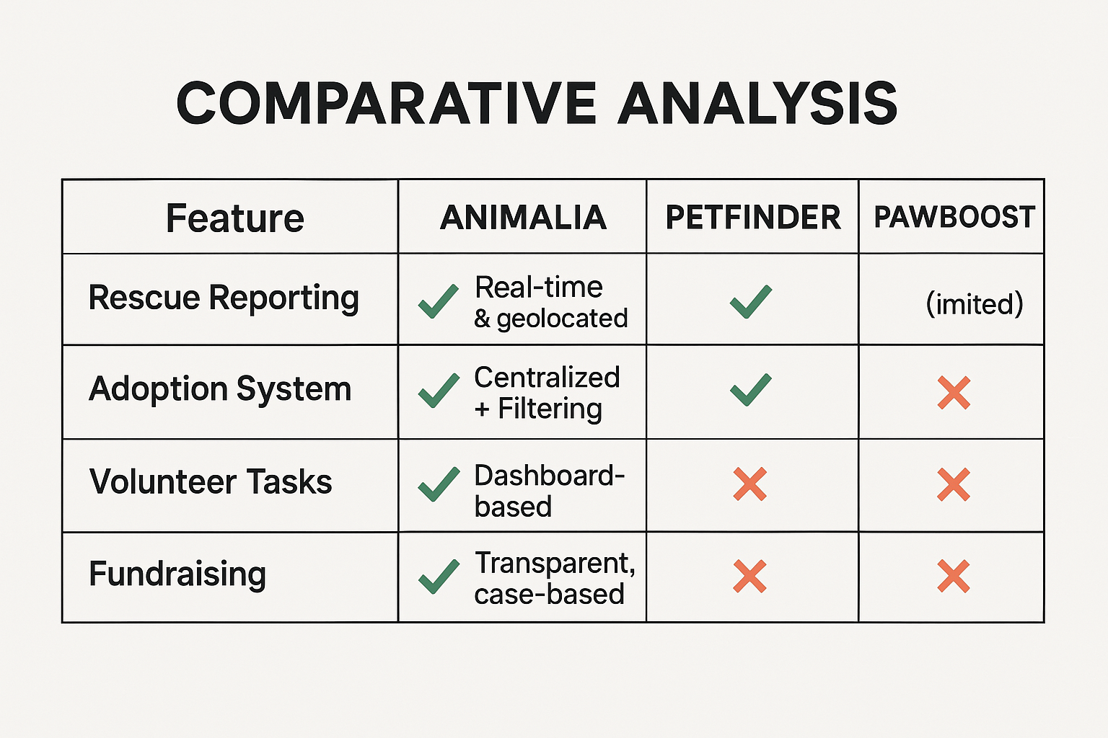
Comparative Analysis

Slide 11
Conclusion & Future Aspects
Software Model Used: Incremental Development Model – builds features in phases with user feedback.
Project Cost: Minimal – Render/Netlify (Free Tiers),Database (MongoDB Atlas Free).
Future Scope:
Mobile app version with push notifications.
Integration with shelter inventory management.
AI Chatbot for FAQ and rescue help.
Public dashboards for analytics on adoptions, rescues, and donations.

Slide 12
Bibliography
MongoDB & Express.js Documentation: Official technical references for MongoDB and Express.js.
MDN Web Docs: Comprehensive guides for HTML, CSS, and JavaScript.
Stack Overflow & GitHub: Platforms for coding support, solutions, and community contributions.
OWASP: Security guidelines for web applications and best practices.
YouTube/Web Tutorials: Video tutorials for learning UI/UX design and full-stack development.

Slide 13
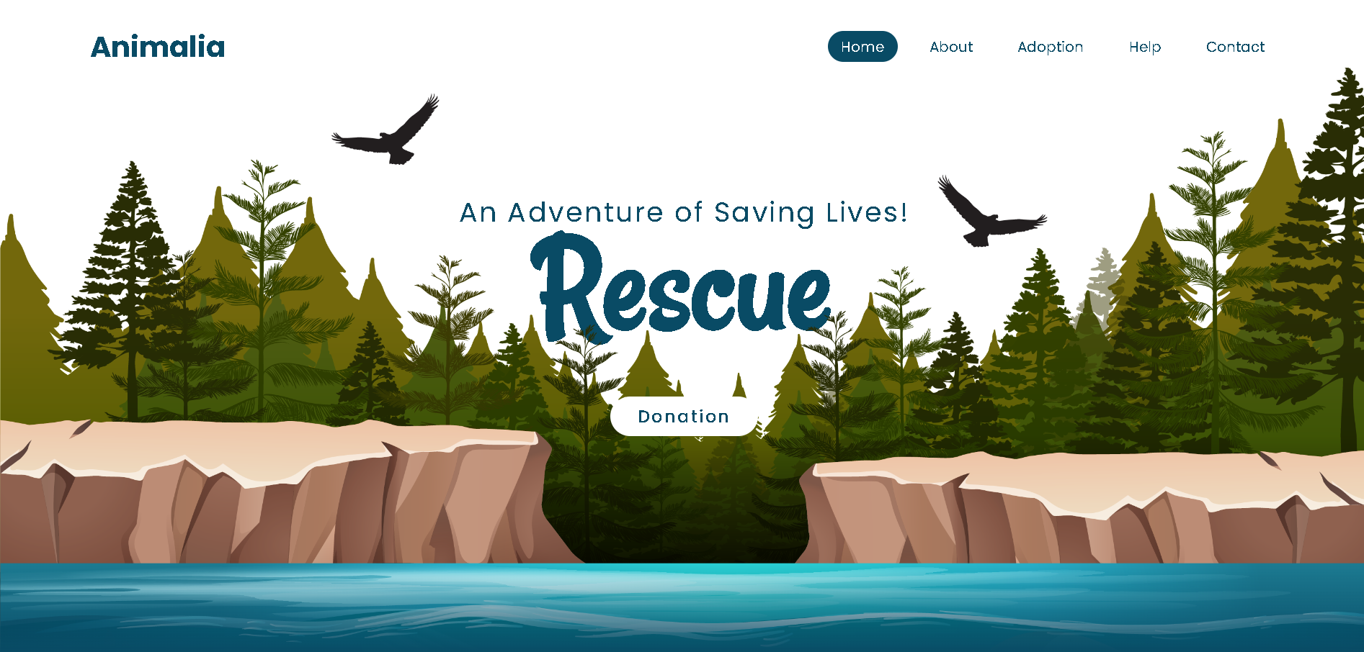
Output

Slide 14
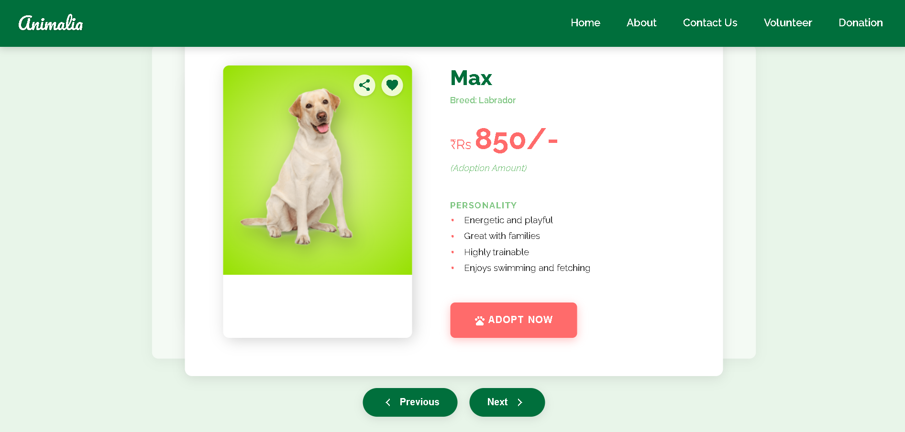

Slide 15
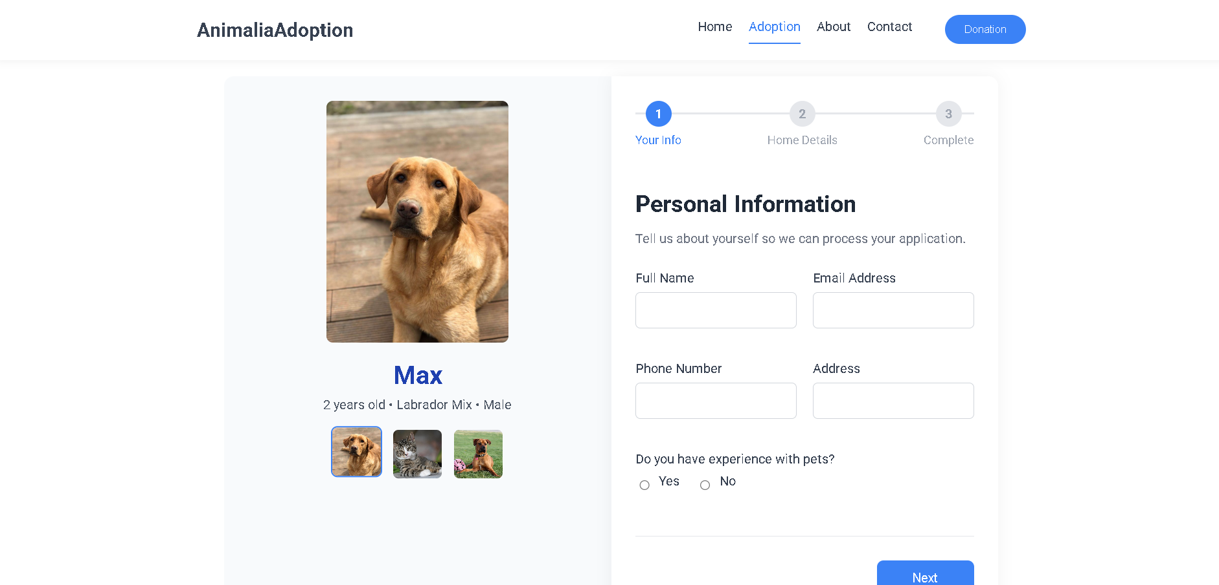
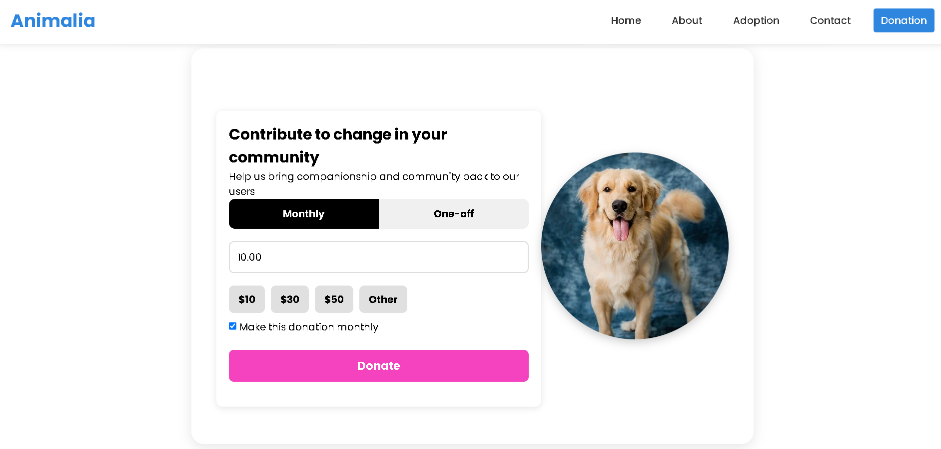

Slide 16
THANK YOU

